Slide 1
Seek Help Before Harm

Slide 2
In the absence of a trusted adult, Safe2Help Illinois offers students a safe, confidential way to share information that might help prevent suicides, bullying, school violence or other threats to school safety. This program is not intended to suspend, expel or punish students. Rather, the goal is to get students to “Seek Help Before Harm.”
Safe2Help Illinois will also develop an educational curriculum aimed at changing the culture in Illinois schools while also providing the resources to help parents and educators reinforce the components of this program.
What is Safe2Help IL?
WWW.SAFE2HELPIL.COM
INFO@SAFE2HELPIL.COM

Slide 3
Safe2Help IL Elements
STUDENT RESOURCES
COMMUNITY OUTREACH
The website, Safe2HelpIL.com, connects students to self-help resources.
Marketing resources are available to help educate parents and community partners about the program
EDUCATIONAL RESOURCES
CONFIDENTIAL HELPLINE
A classroom resource kit is provided and aimed at changing the culture in Illinois schools
Students have a safe, confidential way in which to share information using phone, email, text, mobile app, or web form.
WWW.SAFE2HELPIL.COM
INFO@SAFE2HELPIL.COM

Slide 4
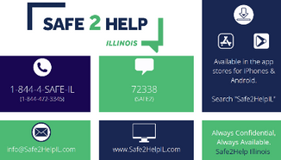
Program Components
Educational
Resources
Report Line
Student Resources
Community Outreach
Website
Self-Help Resources
Videos
Tips & Tools
Classroom Resource Kit
Pre-K - 4th grade
5th -8th grade
9th-12th grade
A 24/7 call center
5 ways to make a report
External SOP
A digital toolkit
Drafted fillable pdf letter
Promotional Materials
12 Days of Kindness Social Media Kit
Ideas on how to promote the program
WWW.SAFE2HELPIL.COM
INFO@SAFE2HELPIL.COM

Slide 5
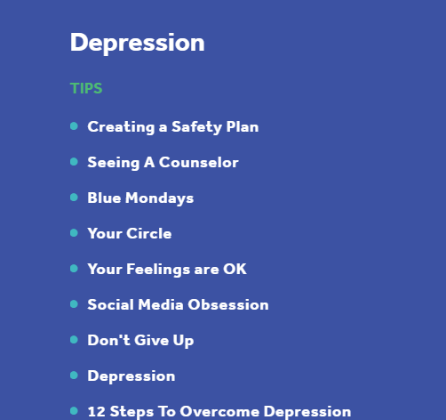
Online Resources
The Safe2HelpIL website provides resources 24/7 for students and the community.
INFO@SAFE2HELPIL.COM

Slide 6
Self-Help Topics
5 self-help topics with more in development
Multiple Tips and Tools for each topic
INFO@SAFE2HELPIL.COM

Slide 7
Videos
Assortment of videos for students, school staff, and parents about the self-help topics and the program.
INFO@SAFE2HELPIL.COM

Slide 8
Promotional Items
Social Media
Promotional Activities
Marketing
Hand Sanitizer
Drawstring bags
Posters
Kindness Awards
Window Clings
Connect Cards
Silicone Wrist Bands
Mask Lanyards
12 Days of Caring Social Media Calendar
Virtual Movie Night
Needs Box
Kindness Messages in bathrooms or on painted rocks
WWW.SAFE2HELPIL.COM
INFO@SAFE2HELPIL.COM

Slide 9
1-844-4-SAFEIL
Safe2HelpIL.com
Safe2
Safe2Help IL How to Report
HELP@Safe2HelpIL.com
WWW.SAFE2HELPIL.COM
INFO@SAFE2HELPIL.COM

Slide 10
Safe2Help IL
Reporting Form
Web & Mobile App Reporting Form
WWW.SAFE2HELPIL.COM
INFO@SAFE2HELPIL.COM

Slide 11
Educational Resource Kit
This is a long-term initiative to change the school culture in Illinois.
Providing a recommended educational curriculum as early as preschool, we hope to:
remove the stigma associated with mental health issues,
foster a culture of kindness,
and instill important lessons.
WWW.SAFE2HELPIL.COM
INFO@SAFE2HELPIL.COM

Slide 12
Pre-K-4th
Be Kind
Telling vs. Tattling
Trusted Adult
Stress & Anxiety
Healthy Relationships
Classroom Resource Kit
5th-8th
Not required
Supplements the IL Social Emotional Learning Standards
Sample activities and videos included
Suicide Prevention
Internet Safety
Self-Injury
Stress & Anxiety
Social Isolation
9th-12th
Call to Action
Help Before Harm
Suicide Prevention
Stress & Anxiety
Social Isolation
WWW.SAFE2HELPIL.COM
INFO@SAFE2HELPIL.COM

Slide 13
Thank you for joining. Any Questions?
For more information email us at Info@Safe2HelpIL.com or
visit our website at www.Safe2HelpIL.com

